Slide 1
Hackathon 2019
TEAM Dataholics

Slide 2




TEAM MEMBERS
Louis Hoang
Harry Le
Jaba Nay
Tony Ngo

Slide 3
Problem
A building company was having a project that its design team had to decide materials for the building.
Small specifications and details add up and the interior designers have little financial incentive to keep costs low.
There are currently no system to automatically flag specified materials which has excessive pricing and to provide alternatives.

Slide 4
Solutions
 We are going to build a database using ML medthods to automatically scrape the data from the reseller's website and assesses the quality of the products .
With machine learning algorithms, a recommendation system for better altenatives will be also be built.
In this way, we can solve 2 aspects of problems:
Quality and Price

Slide 5

Solutions
MACHINE LEARNING

Slide 6
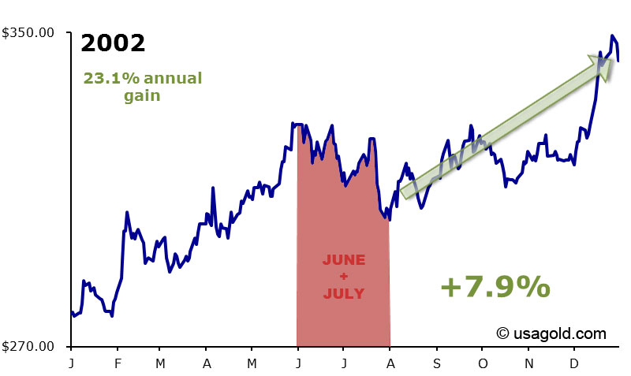
Solutions
MACHINE LEARNING

Slide 7
How it works
Project
Item
NO 🏴
Quantity
YES 🏳
Item Atributes
Examine stores
Pick best choice based on price
Not OK
🏴
OK 🏳
Color
Size
Material
Suggest similar better alternatives while still fulfiliing criteria !
Other models
Based on QL

Slide 8
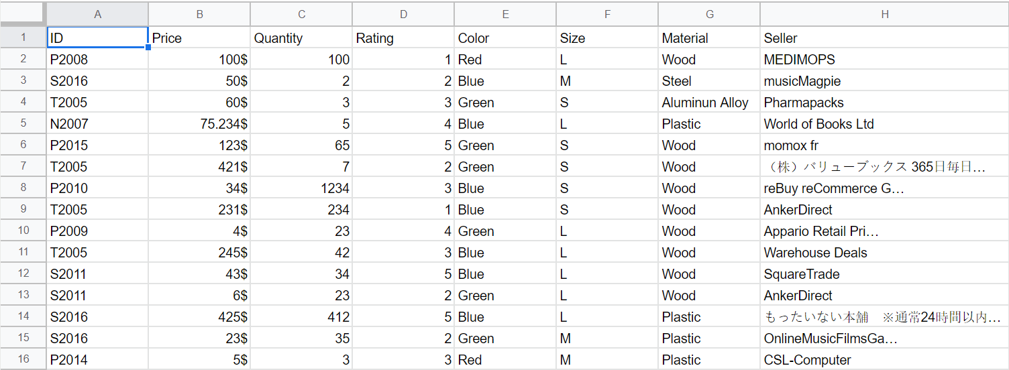
How it works (prerocessed data)

Slide 9
How it works (prerocessed data)

Slide 10
Customers will have more affordable options
Advantages
Reducing excessive pricing
Using data from customers to make reccomendations (related-function product, sales promotion, advertisement, discount)
Providing customers alternative options while still fulfilling the criteria set beforehand-type, price, quality.
Self-developed data pool -> Full control of Database
Renting servers -> massively reduce cost

Slide 11
Collecting data from multiple sources -> takes time to set up the system.
Disadavantages
Require Data Engineers to clean and store data in case data scraping saves incorrect information.
If any problem occurs in the self-developed data pool, we have to find and fix them manually

Slide 12
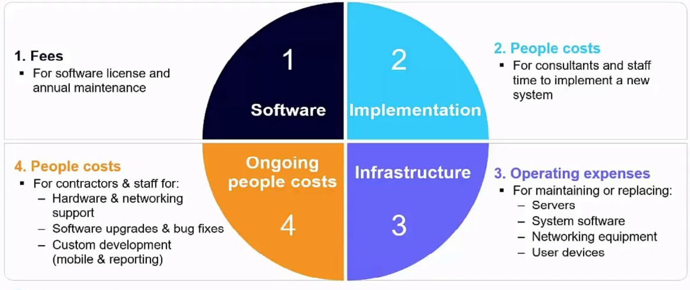


COST OF IMPLEMENTATION

Slide 13

COST OF IMPLEMENTATION

Slide 14

Target customer

Slide 15
Fin
Thank you for listening

